Slide 1
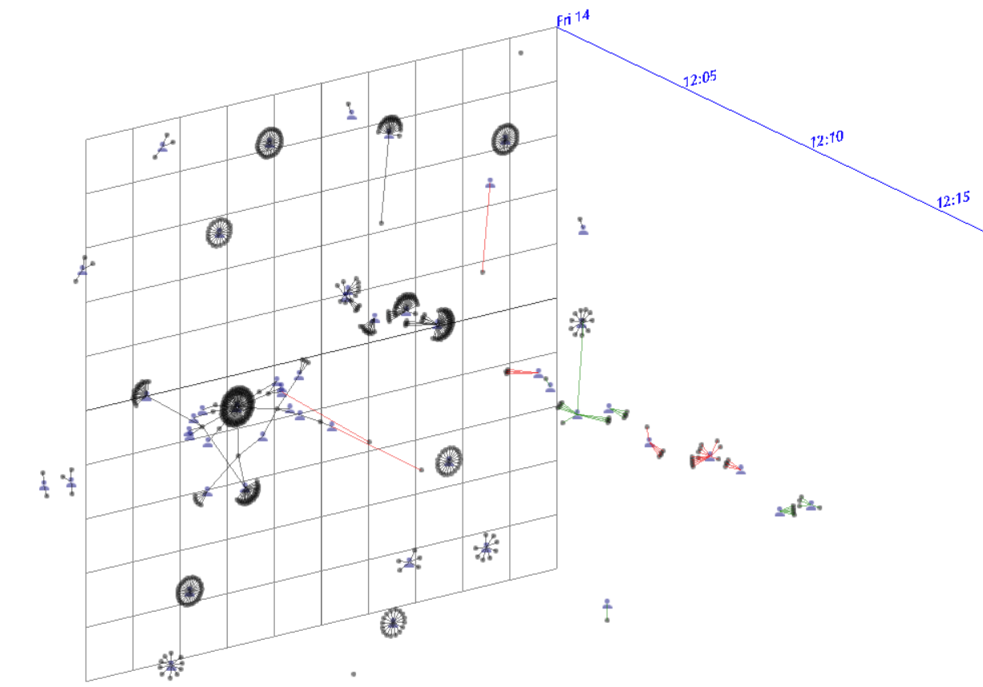
Dynet3D
Weekly report

Slide 2
Dynet3D
25 minutes ⬄ 5 time-steps

Slide 3
Dynet3D
12 hours ⬄ 144 time-steps

Slide 4
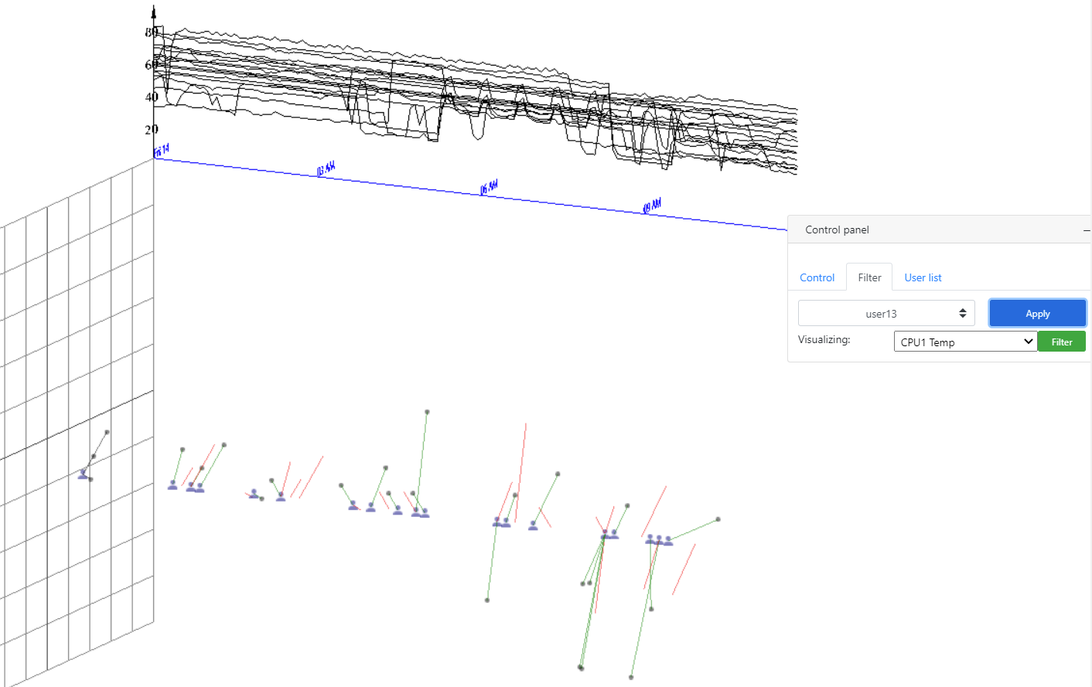
Dynet3D
User has the most changed

Slide 5
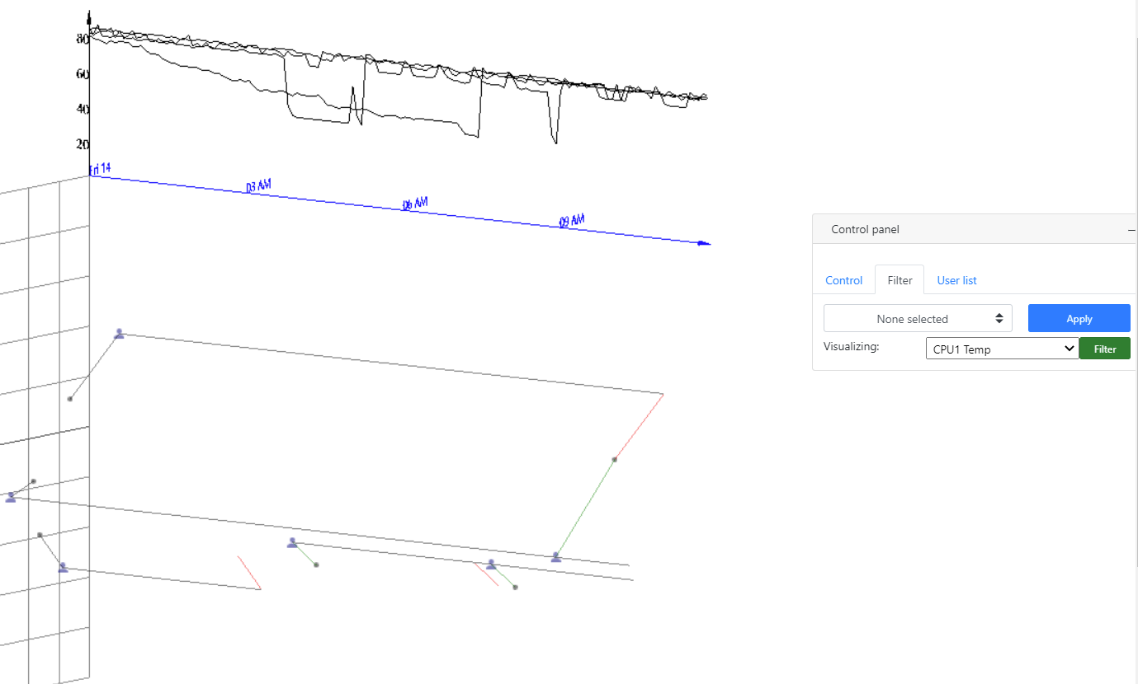
Dynet3D
Filtered Nodes have CPU1 Temp over 90 degree

Slide 6
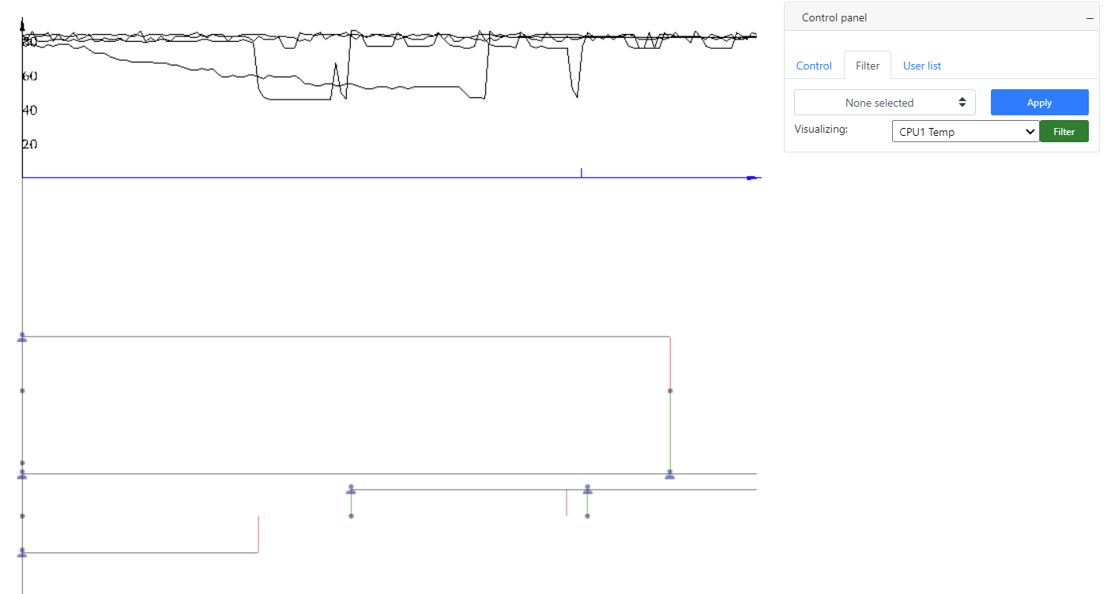
Dynet3D
Filtered Nodes have CPU1 Temp over 90 degree

